Slide 1
Spark graph frames programming examples

Slide 2
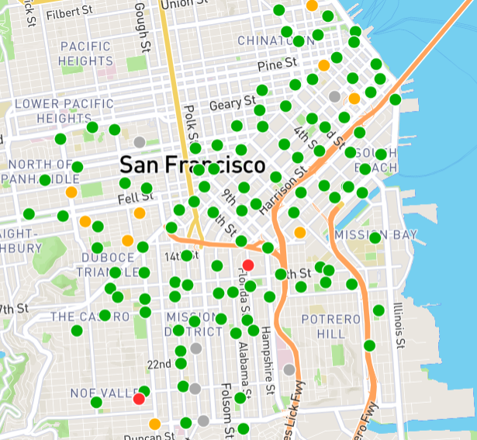
Bike Sharing Example
We will use the following bike sharing example to teach you GraphFrames
Stations (shown using green dots) will be vertices of our graph.
The edges of the graph represent the bike trips that people rode from one station to another.
Each trip has a source and a destination, hence we will be using directed graphs.

Slide 3
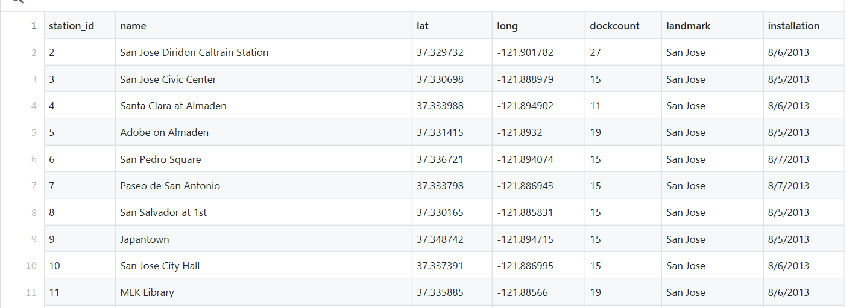
Station Data
201508_station_data.csv
The data can be obtained here: https://github.com/databricks/Spark-The-Definitive-Guide/tree/master/data/bike-data

Slide 4
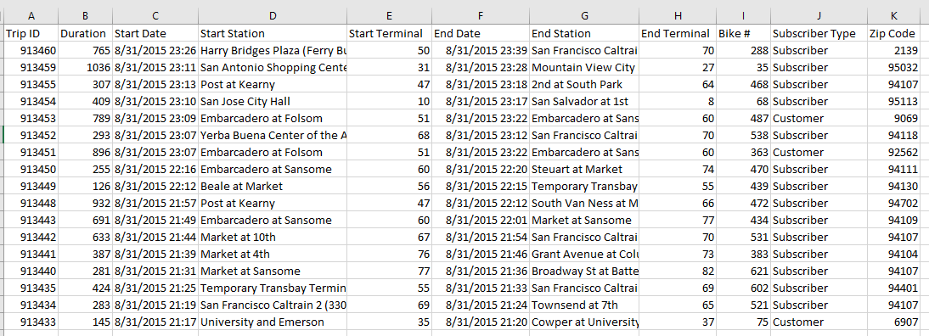
Trip Data
201508_trip_data.csv
The data can be obtained here: https://github.com/databricks/Spark-The-Definitive-Guide/tree/master/data/bike-data

Slide 5
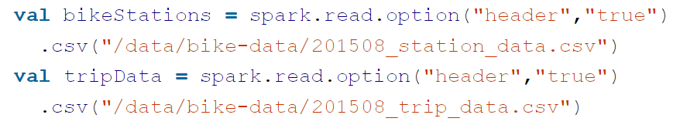
Building a graph
First point spark to the proper GraphFrames package
Load the data

Slide 6
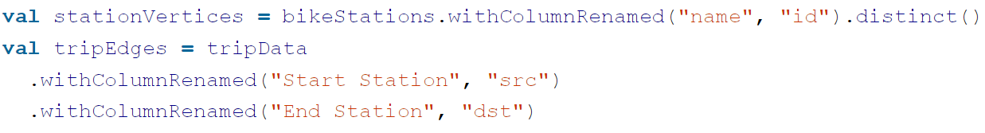
Building a graph
We are building a directed graph.
To build the graph we need to use naming conventions for columns presented in the GraphFrames library (the code below just renames some columns of the dataFrames)
Vertices DataFrame
Define identifiers as id
Edges DataFrame
Define edge’s source vertex ID as src
Define edge’s destination vertex ID as dst

Slide 7
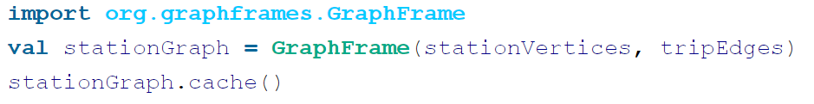
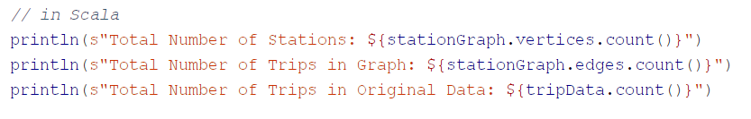
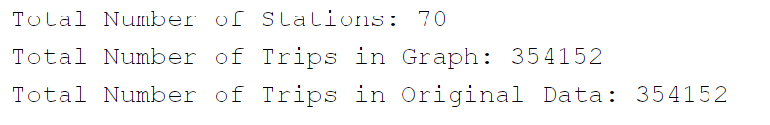
Building a graph
We can now build a GraphFrame object using the vertices and edges defined in the previous slide.
Caching is used since the graph will be used multiple times
We can get some stats:
The following is printed

Slide 8
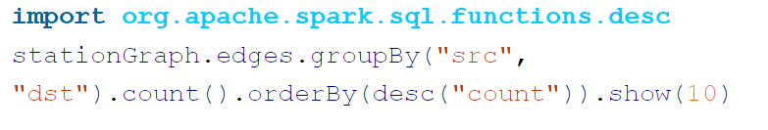
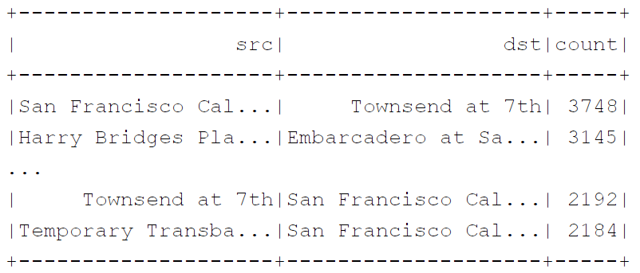
Querying the Graph
We can count the number of times each graph edge is travelled.

Slide 9
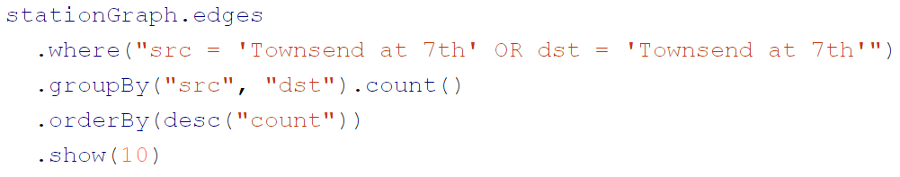
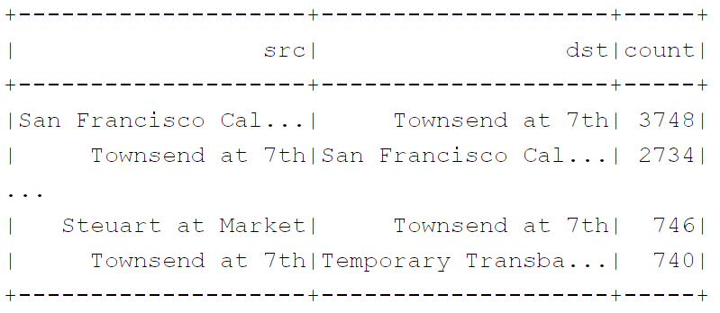
Querying the Graph
Here we want to look at all trips that either start or end from the station “Townsend at 7th”.

Slide 10
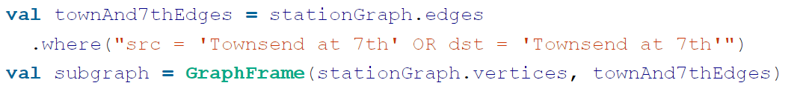
Subgraphs
We can build a subgraph that contains all trips that either start or end from the station “Townsend at 7th”.

Slide 11
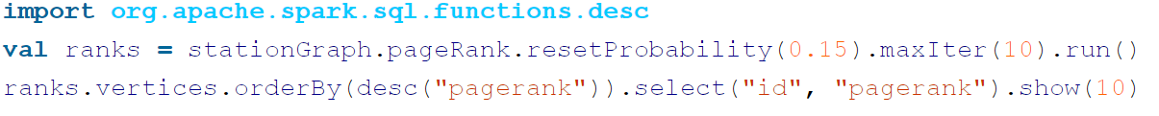
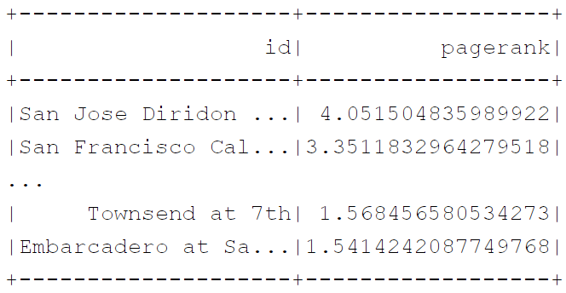
Using Graph Algorithms: Page Rank
GraphFrames have ready made graph algorithms that we can just use.
Here we show how we can use the page rank algorithm to find the most important bike stations.
The ones that receive a lot of bike traffic
In this example the important bike stations will be assigned large page rank values.

Slide 12
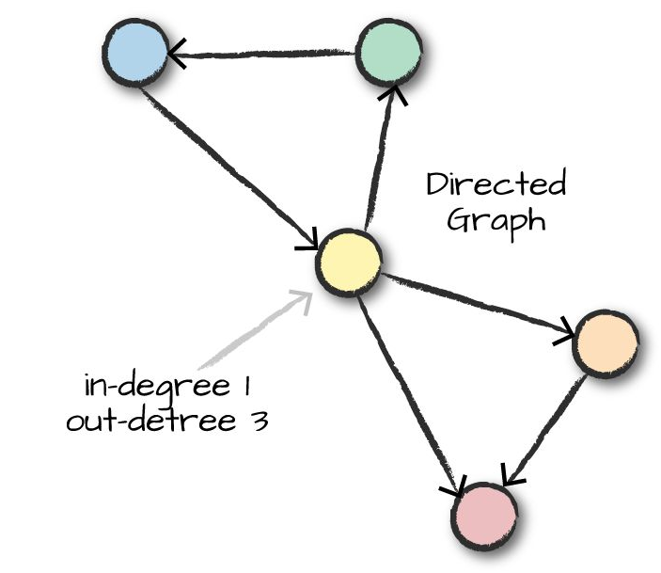
In-Degree and Out-Degree Metrics
It maybe interesting to determine the number of trips into and out of a station.
In social media it is useful to know the number of inbound connections (followers) and out inbound connections (i.e. people they follow).

Slide 13

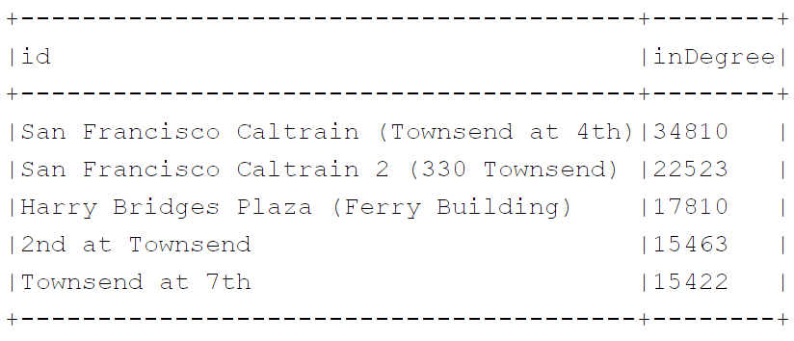
Programing inDegree
Compute the inDegree of all bike stations and sort them in decreasing order of inDegree.
So below it shows the total number of trips into each station sorted in decreasing order of number of trips

Slide 14

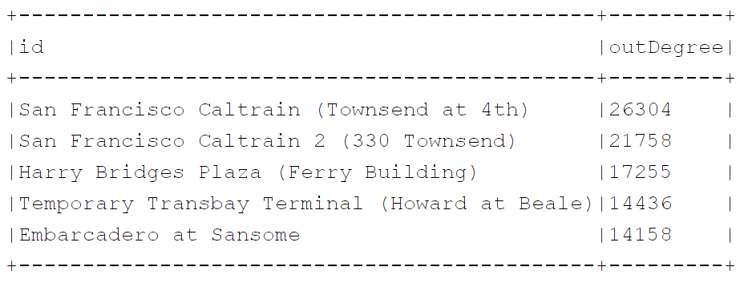
Programing outDegree
Compute the outDegree of all bike stations and sort them in decreasing order of outDegree.
So below it shows the total number of trips out of each station sorted in decreasing order of number of trips

